Slide 1


QUANTITATIVE ANALYSIS
Topic: Analyze customer segments in Europe
LECTURER: HUYNH NAM
TEAM: 16

Slide 2

OUR TEAM MEMBERS
Huynh Thi Thuy Linh
Nguyen Ba Dien
20002435
21004365
Pham Duy Vu
Nguyen Thi My Lien
20000445
20002325

Slide 3



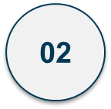

TABLE OF CONTENTS
Introduce
Content
Dashboard design

Slide 4

01
Introduce

Slide 5
ADVENTUREWORKS
Set in a fictional company called AdventureWorks Cycles, a large-scale bicycle manufacturing and selling company.
Includes 5 modules: Sales, Human Resources, Human Resources, Purchasing, Production.
Analyzing customer segments in Europe can help businesses optimize marketing and sales strategies.

Slide 6
02
Content

Slide 7

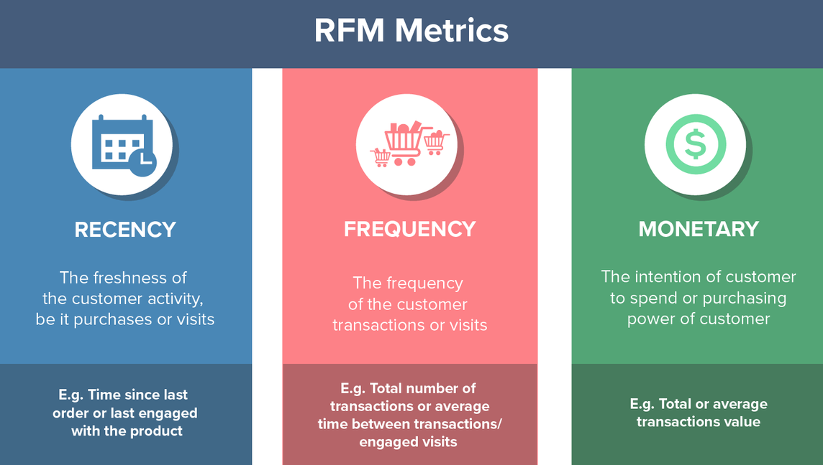
2.1 DETERMINE MEASUREMENTS
R_value (Recency Value)
F_value (Frequency Value)
F_value (Monetary Value)
RFM_Score

Slide 8

2.2 DETERMINE THE DATA TO USE
Sales.Customer
Sales.SalesOrderHeader
Sales.SalesOrderDetail
Production.ProductCategory
Production.ProductSubcategory
Production.Product

Slide 9


2.3 Design data table
CustomerID
CUSTOMERID
ProductID
TerritoryID
SalesOrderID
ProductName
ProductCategory
OrderDate
OrderQty
UnitPrice
Geographical Location (Area of Operation)
R_value, F_value, M_value, R_Score, F_Score, M_Score, RFM_Score

Slide 10

2.4 SYSTEM DEVELOPMENT AND STABILITY DIRECTION
Collect necessary data from customers in Europe
ETL Process
Data Modeling
Analyze customer segmentation
Querying and Reporting
Performance Optimization
Security and Compliance
Support and Monitoring

Slide 11

2.5 EDW SOLUTION
Building Data Warehouse (EDW)
Collect data
Prepare data
Customer segmentation analysis
Plan and implement improvement measures
Monitor and evaluate results

Slide 12


2.6 GUARANTEED POST-LAUNCH SUPPORT
Resolve problems and issues quickly
Increase performance and efficiency
Ensure compliance and security
Ensure project continuity

Slide 13
03
Dashboard design

Slide 14
3. DASHBOARD DESIGN
Connect
Open Power PI, select the Home tab, then select Get data. We will select “excel workbook”. Then, select the excel file to connect to the data. A new tab appears and select the sheet to analyze. Next, select Transforms Data.
Clean data
Remove empty data lines.
Check the data type of each attribute in each table

Slide 15
3. DASHBOARD DESIGN
To create a new measure called 'last transaction date'
Last_transcation_date = MAXX(FILTER('N16','N16'[CustomerName]='N16'[CustomerName]),'N16'[OrderDate])
To create a new measure called 'R value
R_value = DATEDIFF([Last_transcation_date],TODAY(),DAY)
To create a new measure called 'F value’
F_value = DISTINCTCOUNT('N16'[OrderDate])
To create a new measure called 'M value’
M_ value = Sum('N16'[OrderQty])
To create a new table called 'RFM table
RFM Table = SUMMARIZE('N16','N16'[CustomerName],"Recency value",[Recency value],"Frequency value",[Frequency value],"Monetary value",[Monetary value])

Slide 16
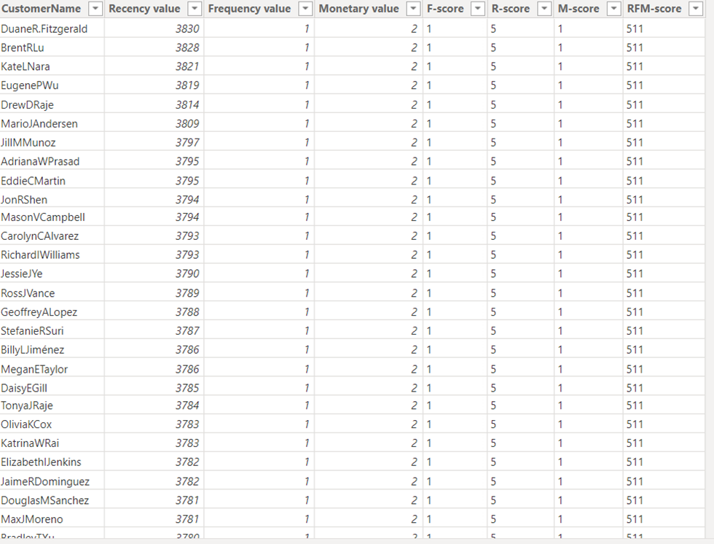
3. DASHBOARD DESIGN
After creating the RFM table, it looks like the following:

Slide 17
3. DASHBOARD DESIGN
Next, we create new columns R_score, F_score, M_score. We group the data into percentiles.
To create a new column called 'R Score’
R-score = SWITCH( TRUE(),
[Monetary value]<= PERCENTILE.INC('RFM Table'[Monetary value],0.20),"1",
[Monetary value]<= PERCENTILE.INC('RFM Table'[Monetary value],0.40),"2",
[Monetary value]<= PERCENTILE.INC('RFM Table'[Monetary value],0.60),"3",
[Monetary value]<= PERCENTILE.INC('RFM Table'[Monetary value],0.80),"4", "5")
To create a new column called 'F-Score’
F-score = SWITCH( TRUE(),
[Frequency value]<= PERCENTILE.INC('RFM Table'[Frequency value],0.20),"1",
[Frequency value]<= PERCENTILE.INC('RFM Table'[Frequency value],0.40),"2",
[Frequency value]<= PERCENTILE.INC('RFM Table'[Frequency value],0.60),"3",
[Frequency value]<= PERCENTILE.INC('RFM Table'[Frequency value],0.80),"4",
"5")
To create a new column called 'M-Score’
M-score = SWITCH TRUE(),
[Monetary value]<= PERCENTILE.INC('RFM Table'[Monetary value],0.20),"1",
[Monetary value]<= PERCENTILE.INC('RFM Table'[Monetary value],0.40),"2",
[Monetary value]<= PERCENTILE.INC('RFM Table'[Monetary value],0.60),"3",
[Monetary value]<= PERCENTILE.INC('RFM Table'[Monetary value],0.80),"4",
"5")

Slide 18
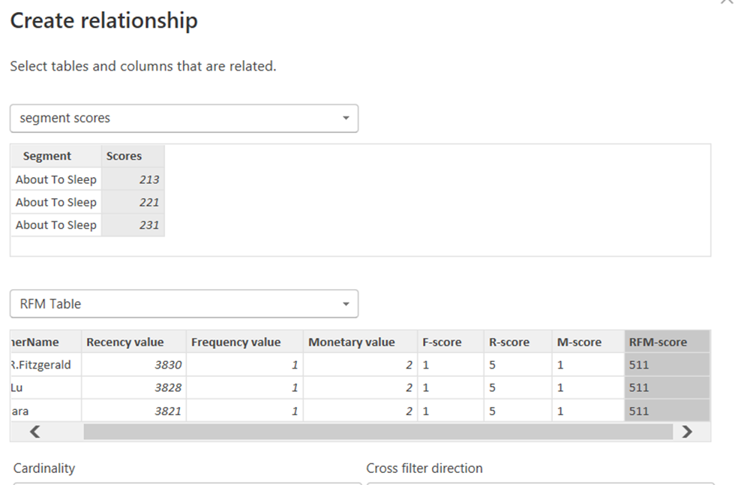
3. DASHBOARD DESIGN
To create a new column called 'RFM’
RFM-score = CONCATENATE(CONCATENATE('RFM Table'[R-score],'RFM Table'[F-score]),'RFM Table'[M-score])
Merge the RFM_table with the Segment_score_table:

Slide 19
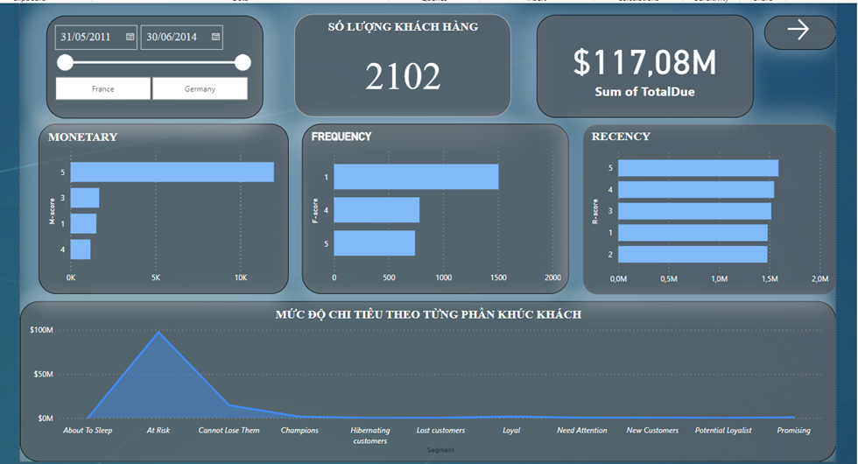
3. DASHBOARD DESIGN
Proceed to design the Dashboard
Dashboard overview

Slide 20

THANK YOU

